Slide 1
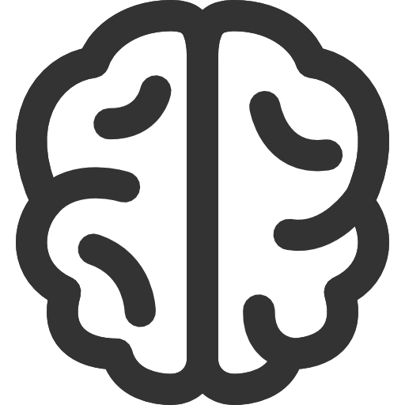


NiMARE: Neuroimaging Meta-Analysis Research Environment
Salo T, Yarkoni T, Kent JD, Gorgolewski KJ, Glerean E, Bottenhorn KL, Bilgel M, Wright J, Reeders P, Nielson DN, Nichols TE, Riedel MC, Sutherland MT, and Laird AR
Neuroinformatics and
Brain Connectivity Lab
Motivation
Getting involved
Objectives
fMRI research is subject to low signal-to-noise, low power, and methodological flexibility.
Meta-analysis alleviates this issue.
Meta-analytic databases make large-scale meta-analysis possible.
Meta-analytic algorithms have been extended for a range of interesting derivative analyses.
We welcome new contributors!
If you know Python or are interested in neuroimaging meta-analysis, check out the contributing guidelines on the project website.
A command line interface for common workflows, with citable write-ups of the methods used!
Interoperability with existing databases like BrainMap, Neurosynth, and NeuroVault.
Methods for database extraction, automated, annotation, meta-analysis, parcellation, and functional decoding.
The Problem
Meta-analytic methods are spread out across a range of UIs and languages. Many never even make it from the paper to a useable implementation.
The Solution
An open-source, collaboratively developed, Python package with a standardized interface and extensive documentation.
Position within the meta-analytic ecosystem
Contact Information: Taylor Salo • tsalo006@fiu.edu

